Slide 1


Welcome to Freedom Park
Mrs. Mary Camp - EIP teacher: K-2nd grade

Slide 2
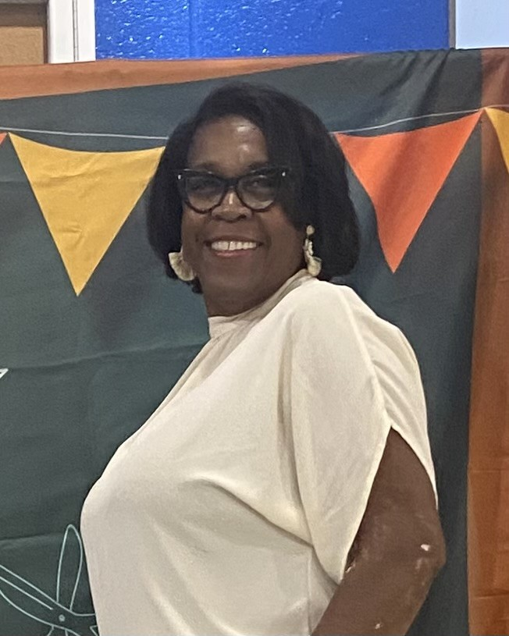
Introduction
My name is Mary Camp. I am excited to serve the EIP students this year. I have taught kindergarten and second grade students. Educating students is my passion. I am married with three children and two grandchildren. I live in Harlem and enjoy the quiet country life.
  (insert picture)

Slide 3
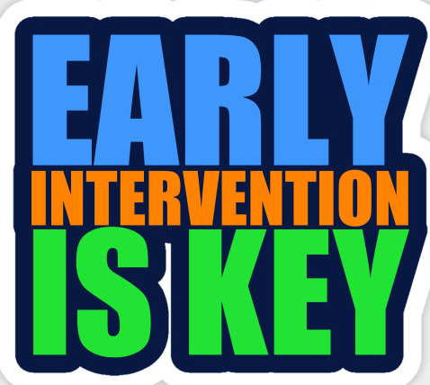
What is EIP?
EIP is an Early Intervention Program (EIP) that is designed to provide interventions for students who are at risk of not reaching or maintaining their academic grade level based on their performance on state or national assessments or performance measures in English Language Arts/Reading, Mathematics, or both in order to help them meet grade-level expectations within a short time period.

Slide 4

What is the purpose of EIP?
The overall aim of the EIP program is to provide additional resources to help students who are performing below grade level to obtain the necessary academic skills in order to reach grade level performance in the shortest time possible.

Slide 5

What does EIP (Early Intervention Program) entails?
Early Intervention programming must involve targeted, evidence-based interventions, frequent progress monitoring, and clear entrance and exit criteria based on grade level performance. It is not the intent of the program for students to be assigned to EIP on a continuing or permanent basis. ​

Slide 6


What type of a teacher is an EIP teacher?
EIP teachers are certified teachers who specialize in using strategies to help meet students’ needs where gaps exist in the areas of Language Arts and Mathematics.

Slide 7


How will I know if my child qualifies for EIP?
One of the many components of the EIP program is parental involvement. Students who qualify as EIP will receive a letter home. Parents should read the letter, sign, and return it to school indicating that they are aware of their child's EIP status.

Slide 8


EIP is NOT Special Education.
It is in addition to regular instruction in the classroom. It does NOT take the place of regular classroom instruction. EIP is “extra help,” like a band-aid. Students have many successful skills, but a few ‘holes’ here and there that need to be filled. Our role is to make them ‘whole.’ Everyone’s ‘holes’ or gaps are different sizes and different places.

Slide 9

Contact Me
If you have any question, please feel free to contact me @ campma@boe.richmond.k12.ga.us.

Slide 10



